Slide 1

Day - 3
Sales Order , Sales Order Item – Get Method’s
Association between Sales Order and Order Items
Defining Deep Entity
Implementation of Deep Entity
Image Processing
Understand Payload
Testing in Postman Tool
What is Function Import
How to Use Function Import
Implementation of Function Import
OData Service Extension

Slide 2
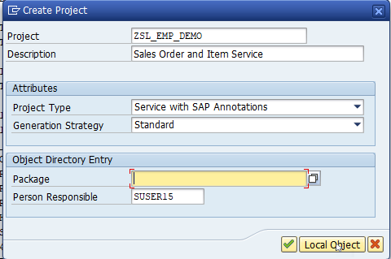
Build OData Service for Sales Order Header And Sales Order Item Data
Introduction
01
Software Innovation
02

Slide 3
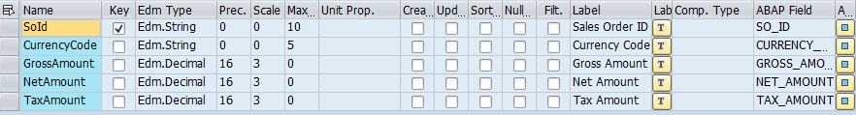
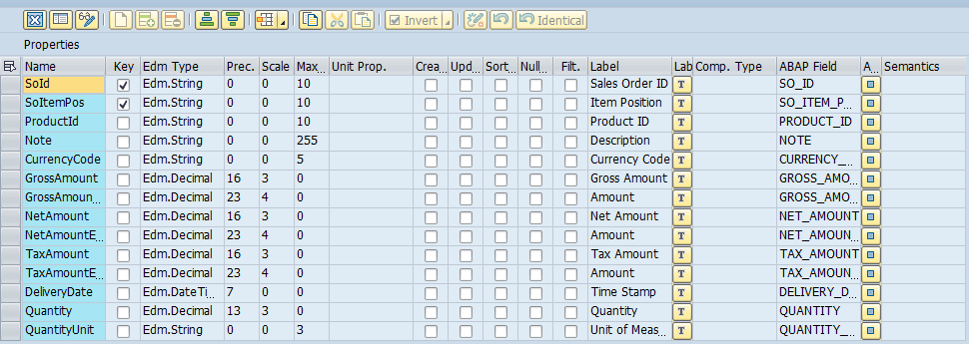
Building Entity Type
Sales Order Entity Type Properties
Sales Order Items Entity Type Properties
01
Software Innovation
02

Slide 4
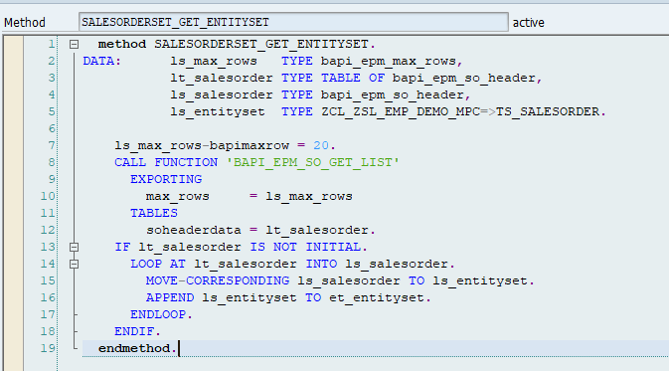
Building Get EntitySet for Sales Order
Go to DPC extension and redefine the method for SalesOrderSet Get EntitySet
Introduction
01
Software Innovation
02
Hardware Innovation
Note: Click on the image to get Complete code.

Slide 5
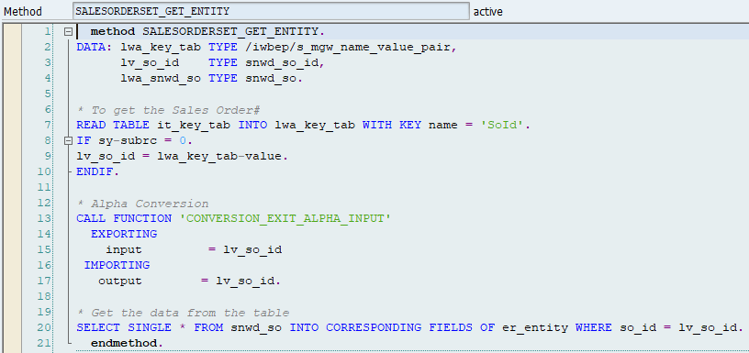
Building Get Entity(Single Record) Method
Go to DPC extension and redefine the method for SalesOrderSet Get Entity
Introduction
01
Software Innovation
02

Slide 6
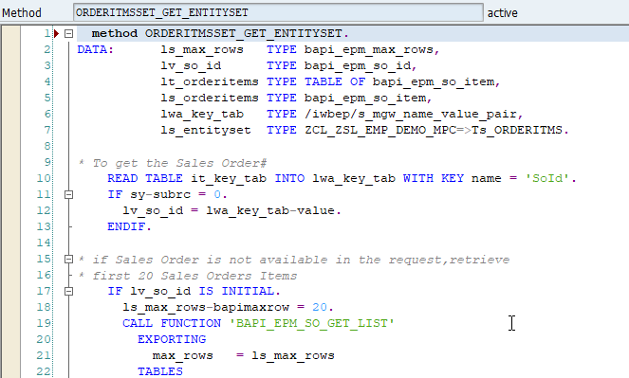
Building Get Entity Set Method for OrderItems
Go to DPC extension and redefine the method for OrderItmsSet Get EntitySet
Introduction
01
Software Innovation
02

Slide 7
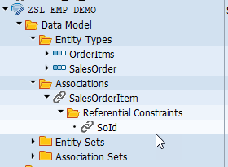
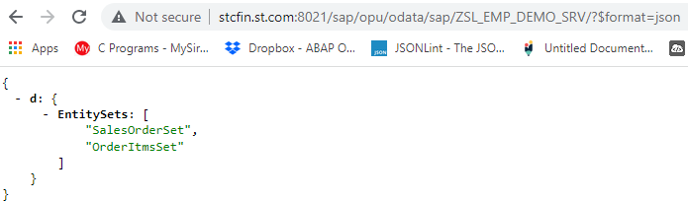
Association Between Sales Order and Sales Order Item
Introduction
01
02

Slide 8
Defining Deep Insert
Deep insert is used to POST the nested structure of feed/collections to the back-end system. It is opposite to the $expand in which we GET the nested structure of collections. By implementing this you can reduce the no. of OData calls made to the SAP NetWeaver Gateway server.
SAP Gateway Deep Inset allows to store hierarchical data like in our case Sales Order that has both header and item data (one can not exist without another). ... Deep Inset is an opposite to $expand URI option.
Introduction
01

Slide 9
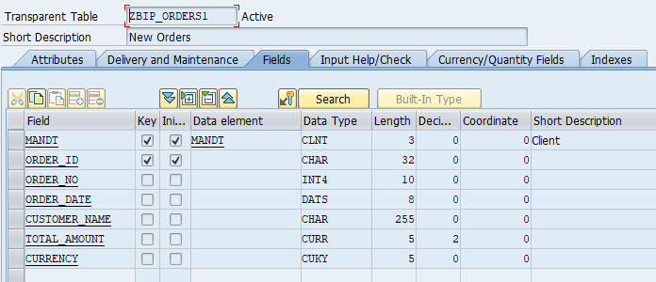
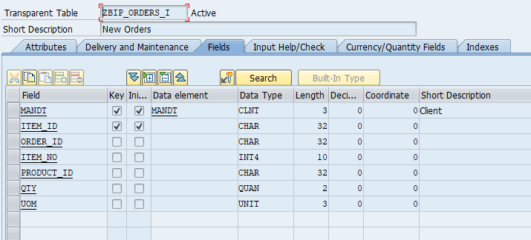
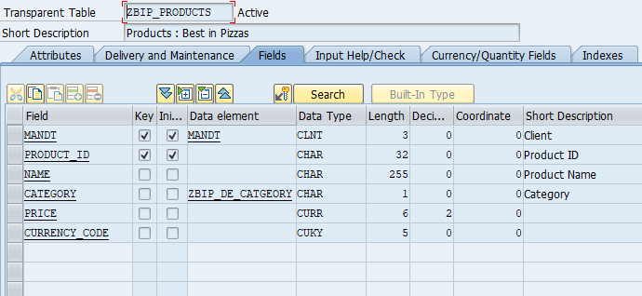
Building Deep Insert Scenario
Create Custom Table for Orders, Order Items and Products Data
1
2
Introduction
3
Hardware Innovation

Slide 10
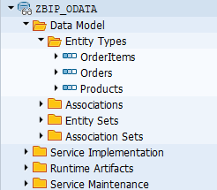
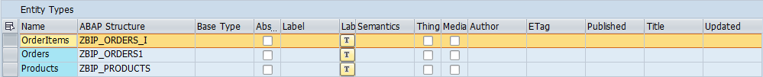
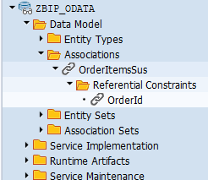
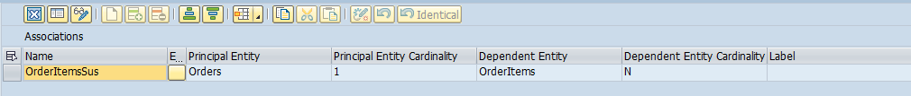
Create OData Service
Create an OData Service With 3 Entity Types and One Association Between Orders And Order Item( 1..N)
02
Association Between Orders and Order Items

Slide 11
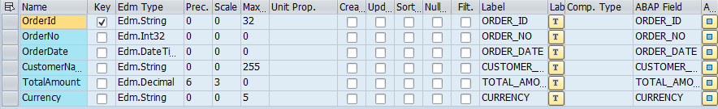
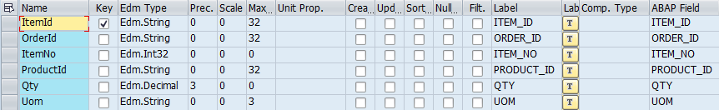
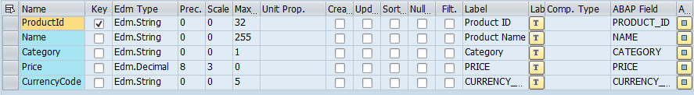
Entity Type
1. Orders Properties
2. Order Items Properties
3. Products Properties
02

Slide 12
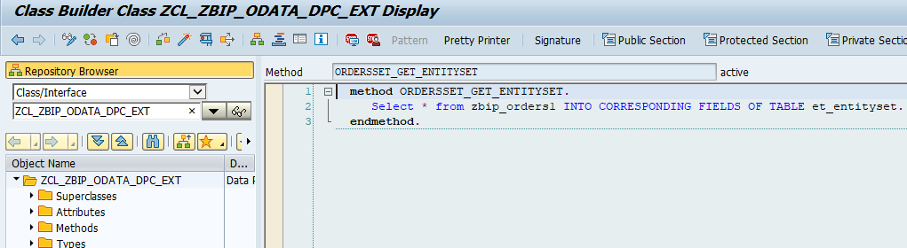
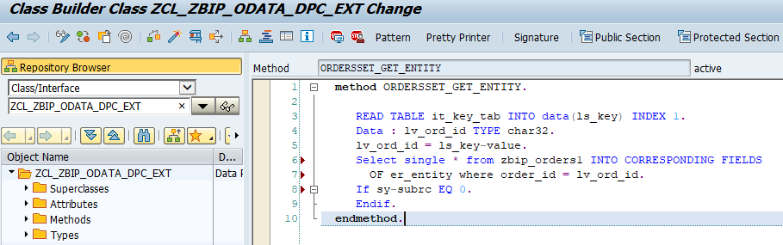
Building Get Entity Set for Orders
Go to DPC extension and redefine the method for Orders Get Entity Set
Introduction
Building Get Entity(Single Record) for Orders
Go to DPC extension and redefine the method for Orders Get Entity
01
02
Hardware Innovation
Note: Click on the image to get Complete code.

Slide 13
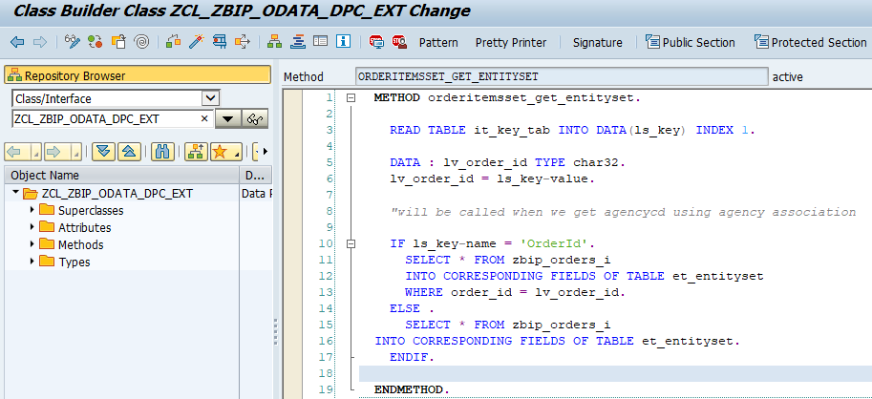
Building Get Entity Set for OrderItems
Go to DPC extension and redefine the method for OrderItems Get Entity Set
Introduction
01
Software Innovation
02

Slide 14
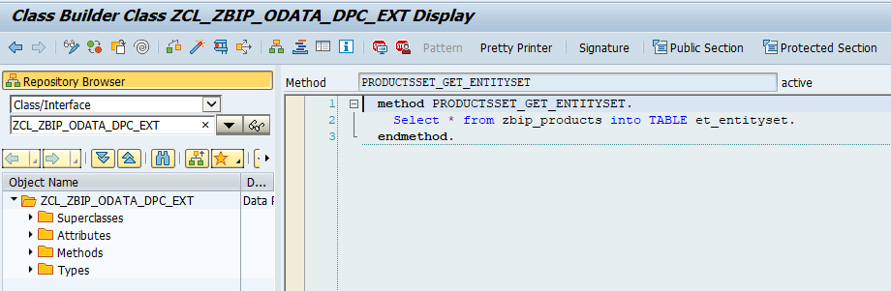
Building Get Entity Set for Products
Go to DPC extension and redefine the method for OrderItems Get Entity Set
Introduction
01
Software Innovation
02

Slide 15
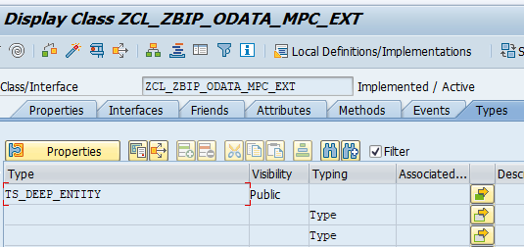
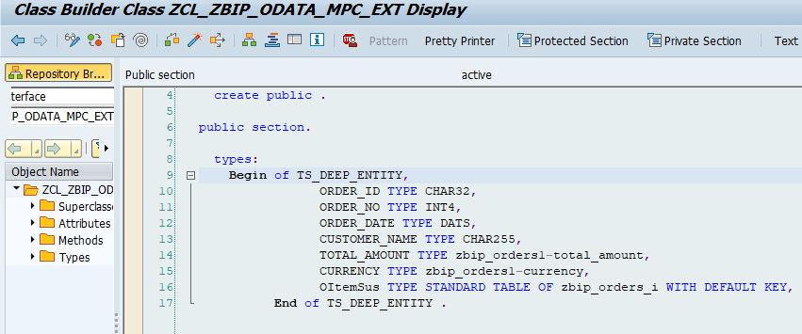
Create Type in MPC_EXT Class
Go to MPC extension and Create Types for Deep Entity “TS_DEEP_ENTITY”
Create Structure of Deep Entity their.
01
02

Slide 16
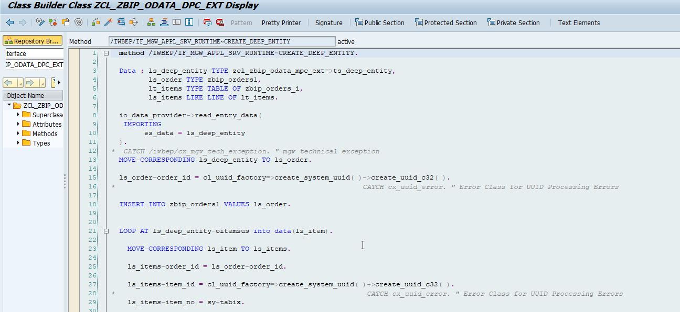
Building Code for Deep Entity
Go to DPC Extension and search for the method--/IWBEP/IF_MGW_APPL_SRV_RUNTIME~CREATE_DEEP_ENTITY and redefine the class method.
Introduction
01
02

Slide 17
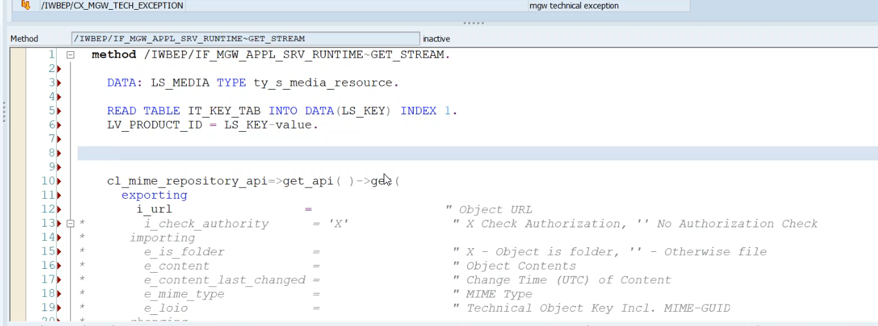
Image Processing
In ABAP all images are store in MIME Repository. To see MIME Repository
go to se80 > utilities > settings > MIME Repository
to add Image in OData
Step1: Go to service > entity Type > Create Copy of Product >select the media check box
Step2: Now add two new property to Product Set
- Product_pic_url
- MIME_TYPE
Step3: Go To MPC Extension Class and redefine the DEFINE method(for code ClickHere)
Step4: Go to DPC Extension class and redefine the Method Get_Stream (for code ClickHere)
Introduction
01
02

Slide 18
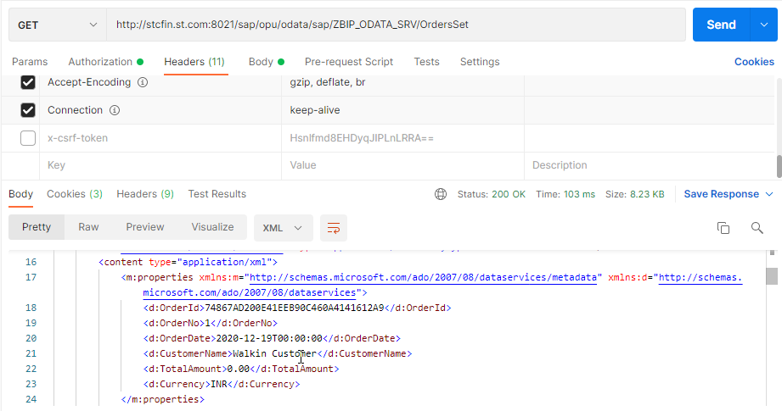
Test OData Service in Postman
Service URL
Introduction
01
Software Innovation
02

Slide 19
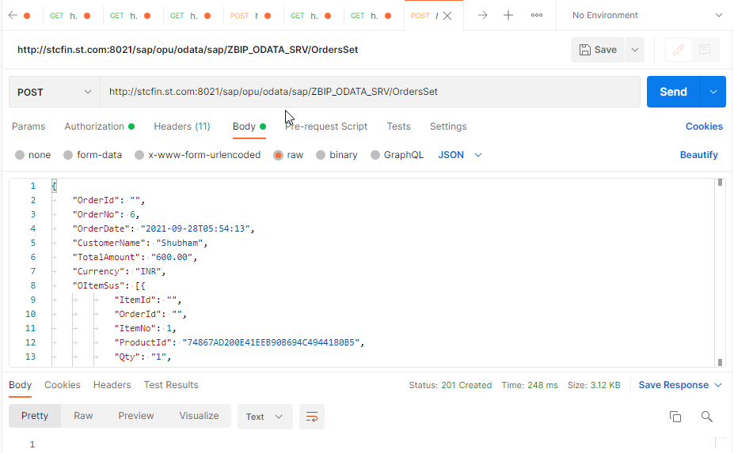
Preparing Payload for Deep Entity
{
"OrderId": "",
"OrderNo": 6,
"OrderDate": "2021-09-28T05:54:13",
"CustomerName": “Anubhav",
"TotalAmount": "600.00",
"Currency": "INR",
"OItemSus": [{
"ItemId": "",
"OrderId": "",
"ItemNo": 1,
"ProductId": "74867AD200E41EEB90B694C4944180B5",
"Qty": "1",
"Uom": "PC"
},
{
"ItemId": "",
"OrderId": "",
"ItemNo": 2,
"ProductId": "74867AD200E41EEB90B6968C5DA840B7",
"Qty": "1",
"Uom": "PC"
}
]
}
Introduction
01
Software Innovation
02

Slide 20
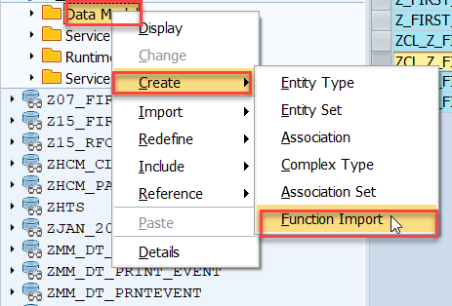
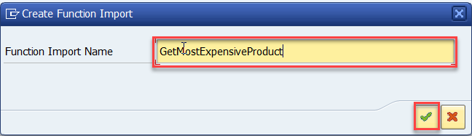
Function Import
At times, we need to implement the logic inside of OData which is not a direct CRUD operation e.g. calling a workflow, calling a BAPI which does some processing, Sending request to another server and can be invoked by the HTTP methods GET or POST .
For example: we can create the function import to GetMostExpensiveProduct in our Product set by the Category.
Step1: Right click the Data Model folder, and select Create and then select Function Import. Create Function Import dialog opens
Introduction
01
02

Slide 21
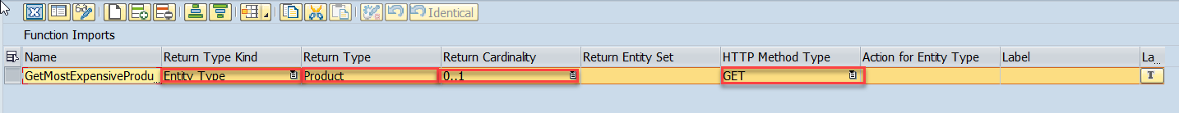
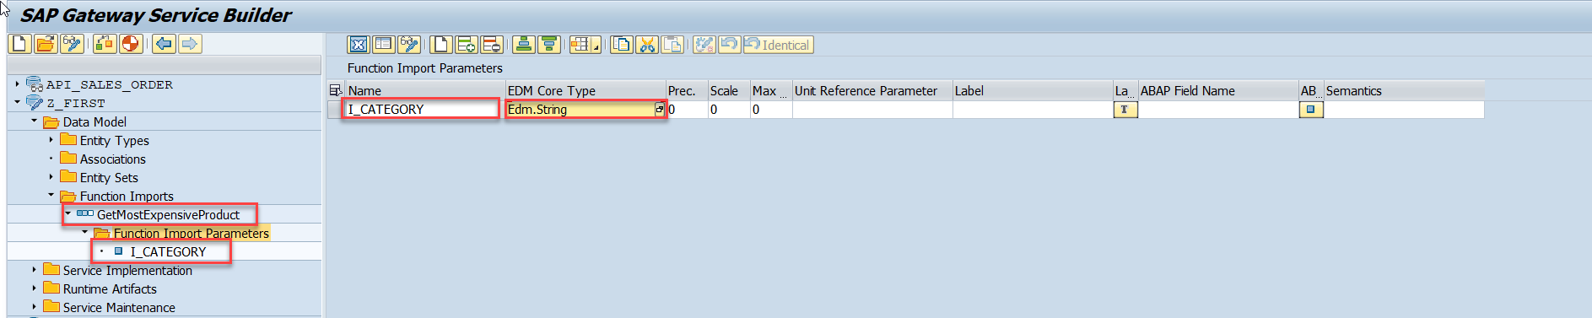
Steps for Creating Function Import
Step2: Enter return type kind, return type, return cardinality & HTTP method Type
Introduction
Step3: Giving function import parameters (I_CATEGORY)
01
Software Innovation
02

Slide 22
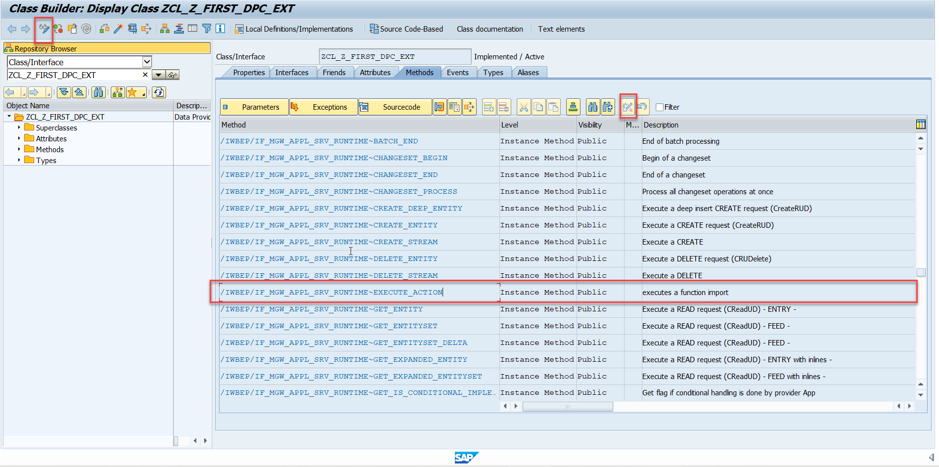
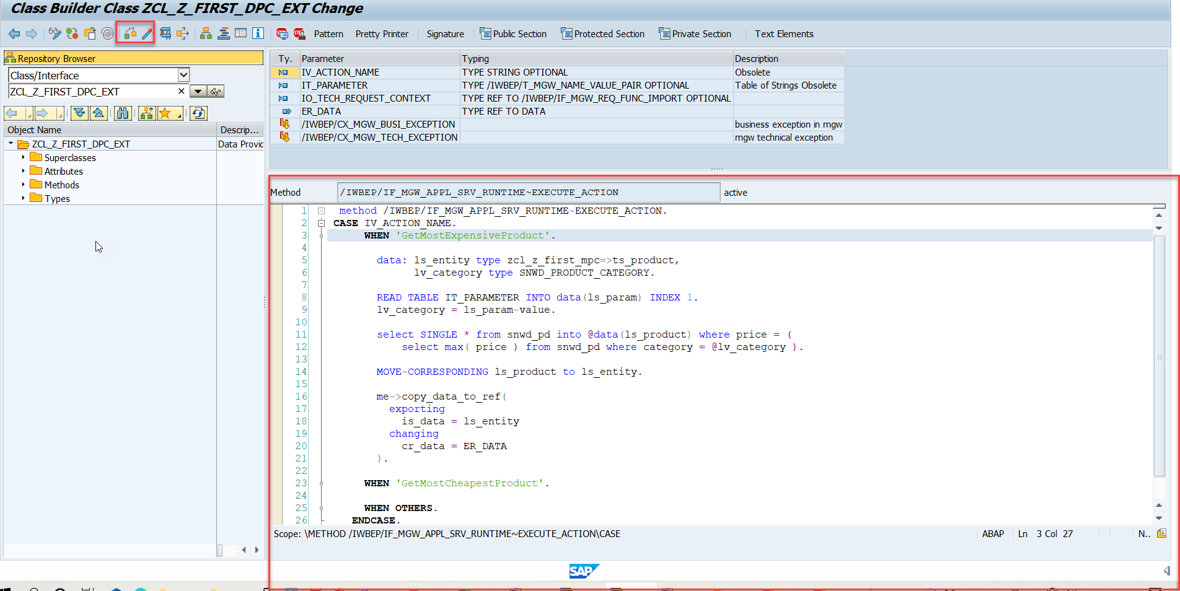
Steps for Creating Function Import
Step4: Go to DPC Extension and search for the method--/IWBEP/IF_MGW_APPL_SRV_RUNTIME~EXECUTE_ACTION and redefine the class method
Introduction
01
Software Innovation
02

Slide 23
OData Extension
Extend Standard OData Service with use of following Steps
Identify the standard app OData service.
Identify the corresponding ABAP DDIC Structure for the entity to be extended.
Create a custom GW project & redefine the standard OData service.
Add custom fields to entities (you want to extend).
Implement BADI for fetching and manipulating the new data.
Regenerate & Register the new app.
Introduction
01
02

Slide 24
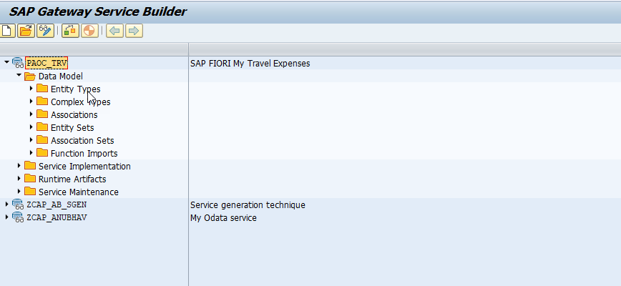
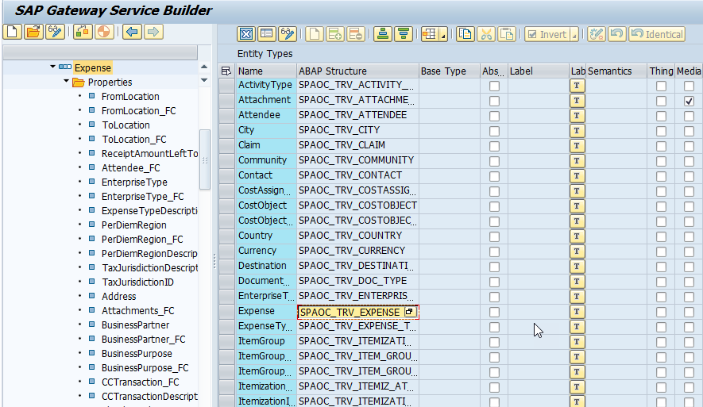
OData Extension
Step 2 – Go to Expense Entity Type and Grab the
ABAP Structure “SPAOC_TRV_EXPENSE”.
Introduction
Step 1 – Add Standard OData Service in our Service Builder
“PAOC_TRV”
01
02

Slide 25
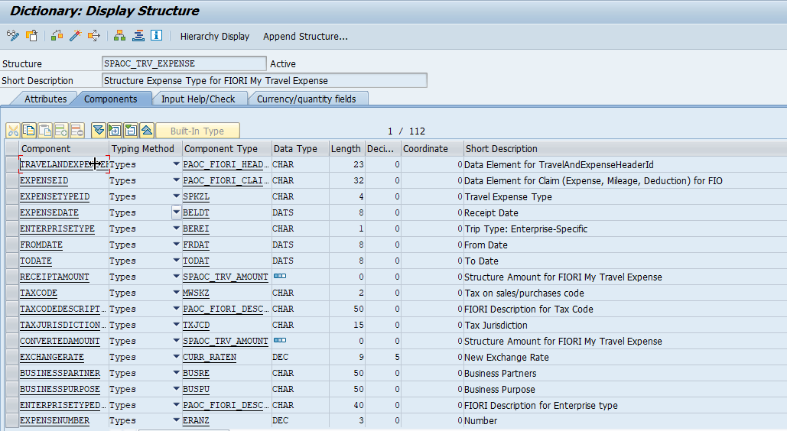
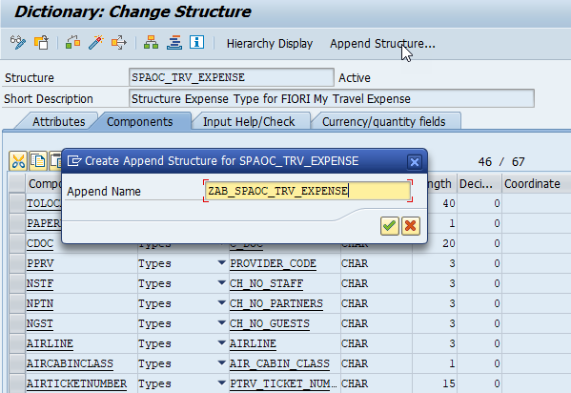
OData Extension
Step 4 – Append Structure “ZAB_SPAOC_TRV_EXPENSE” .
Introduction
Step 3 – Go to se11 and See the Structure.
02
Hardware Innovation

Slide 26
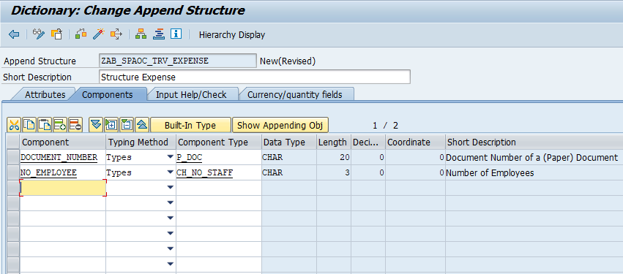
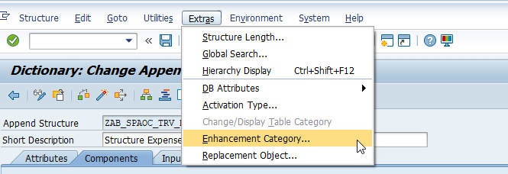
OData Extension
Step 5 – Append 2 Fields
DOCUMENT_NUMBER NO_EMPLOYEE.
Introduction
01
Step 6 – Go to Extras select Enhancement Category.
02
Hardware Innovation

Slide 27
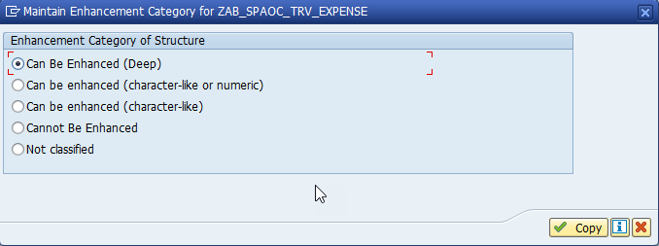
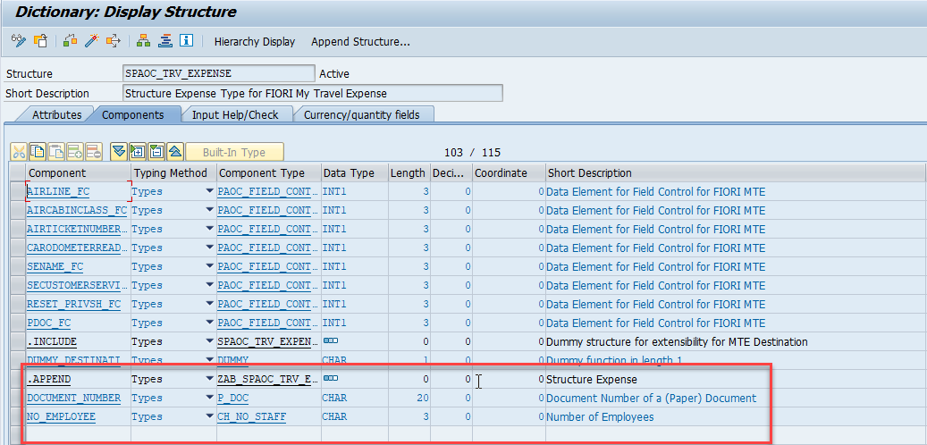
OData Extension
Step 7 – Select “Can Be Enhanced ( Deep )”.
Introduction
01
Step 8 – See fields in our main Structure and Activate it.
02

Slide 28
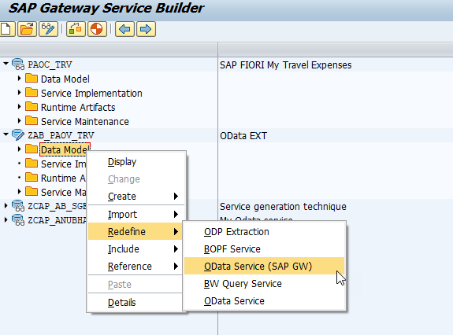
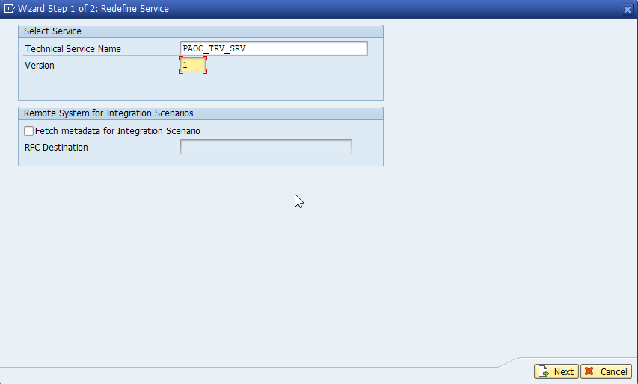
OData Extension
Step 10 – Gave the Name of Standard OData Service
and Click on Next.
Introduction
01
Step 9 – Create new project and Redefine
and Click on OData Service
02
Hardware Innovation

Slide 29
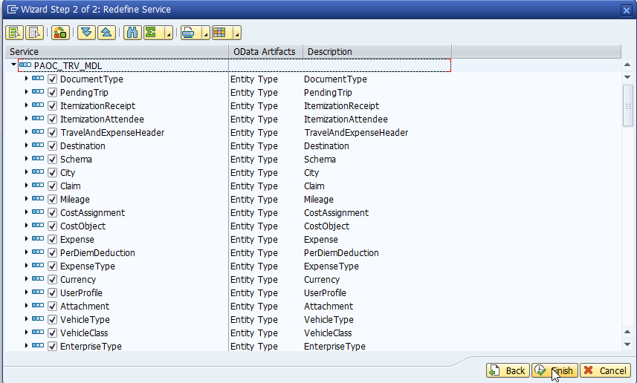
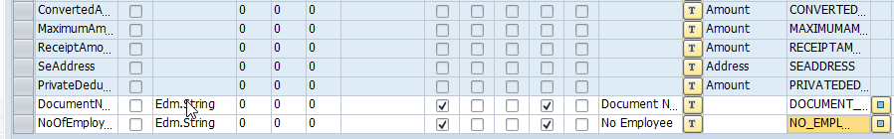
OData Extension
Step 11 – Select all Field and Next.
Introduction
01
Step 12 – Append two more Property
02
Hardware Innovation

Slide 30
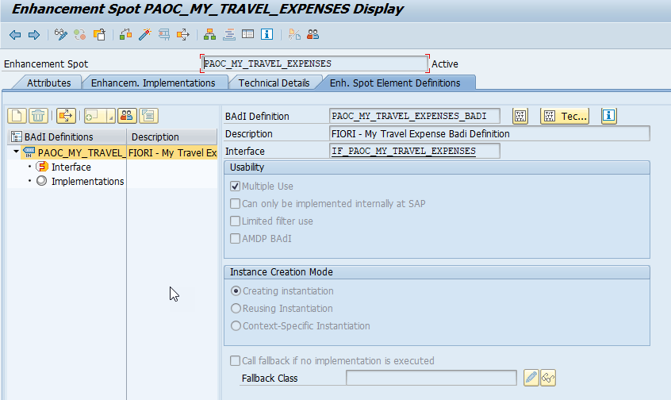
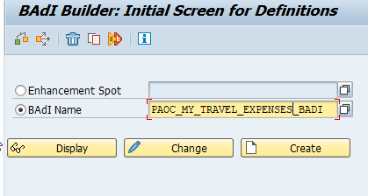
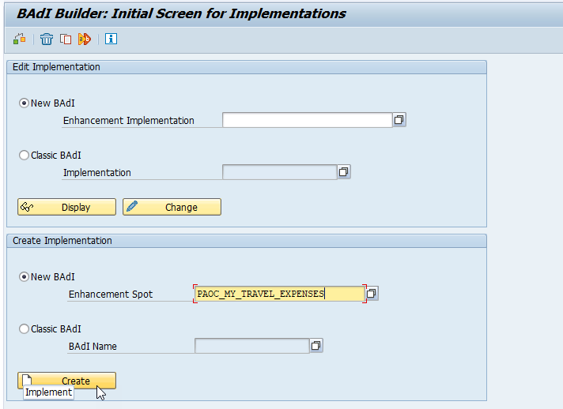
OData Extension
Introduction
Step 13 – Go to se18 Tcode and gave the
BADI “PAOC_MY_TRAVEL_EXPENSES_BADI”.
Step 14 – Go to se19 Tcode and Paste the Enhancement spot name “PAOC_MY_TRAVEL_EXPENSES”
And Click on Create
01
02

Slide 31
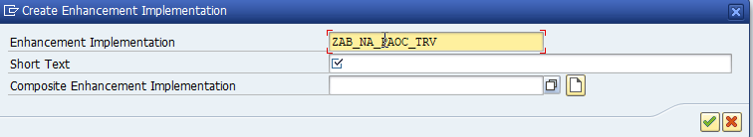


OData Extension
Step 15 – Give Name of new Enhancement Implementation
Introduction
01
02
Hardware Innovation

Slide 32


OData Extension
01
Step 16 – Click On Copy Sample Class and new Enhancement Implementation Created.
02

Slide 33

OData Extension
Step 17 Register the Service and Regenerate it & Test the Service in Browser for see the metadata .
Introduction
01
02
Hardware Innovation

